Slide 1

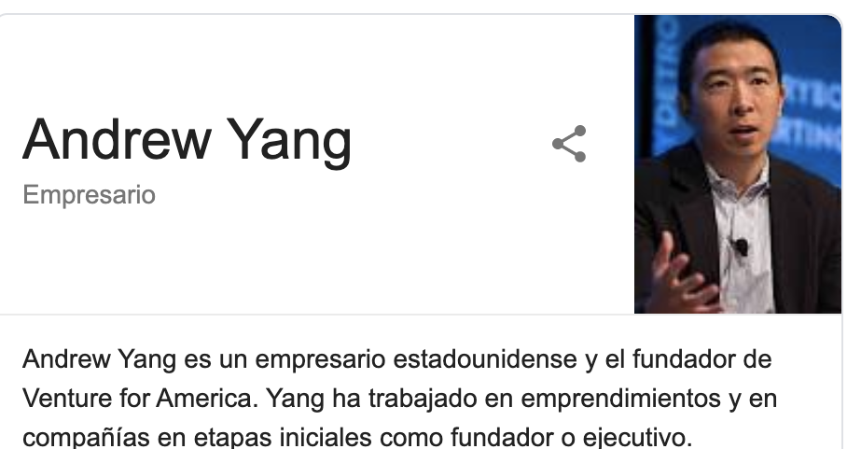
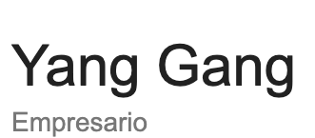
REPLACE “ANDREW YANG” WITH
“YANG GANG”
BEFORE
AFTER

Slide 2
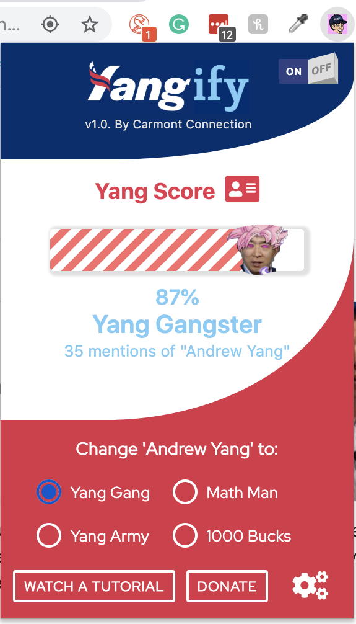
DETERMINE THE
YANG SCORE
OF ANY WEBSITE

